Slide 1
Activity Insight
Adding Intellectual Contributions

Slide 2
Login to the System
https://www.digitalmeasures.com/login/nova/faculty/authentication/showLogin.do?shce=1
Select - Manage Activities
Select - Intellectual Contributions.
Located under the Scholarship/Research heading
Select - Add New Item

Slide 3
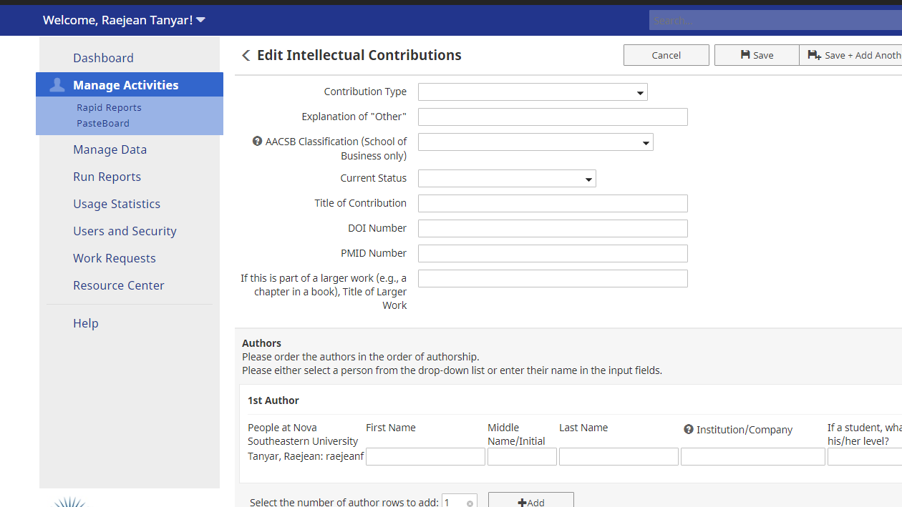
Only specific types of Contributions are acceptable by AACSB & HCBE

Slide 4
Items Required to show on reports
For AACSB Table 2-1(AACSB Standard 2)
Contribution Type
Select from the dropdown menu. Not all types of Contributions listed are acceptable to AACSB & HCBE (this is an NSU-wide system). See Guidance Document for additional information.
Presentations should be added on the Presentations Screen, Not the IC Screen
AACSB Classification
AACSB expects we will have a portfolio of ICs in all three categories
•Basic/discipline-based •Applied • Teaching & learning
With our applied mission, the expectation is that we will have a higher percentage of applied research.
Current Status
Only Accepted or Published Items are included on reports – You must include Date of Acceptance and/or Date Published for item to be included on reports
You can still add non-accepted/published items. Choose the appropriate status, then come back later to update the item as it moves through the publication process.

Slide 5
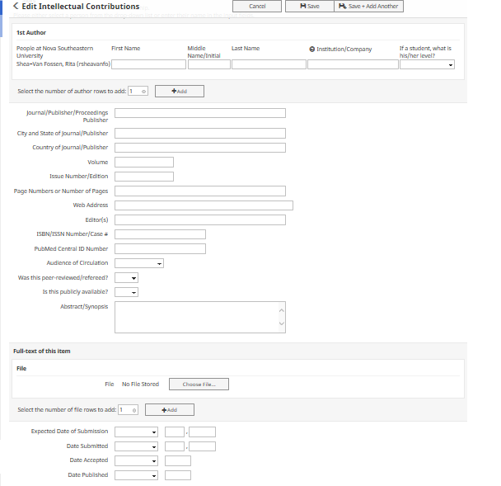
For NSU Co-Authored ICs
Have only 1 author enter IC
It will show on all authors’ CVs

Slide 6
Accurate Data Entry leads to accurate Reporting.
Items Required to show on reports
Continued
Date of Acceptance and/or Date Published
You must include Date of Acceptance and/or Date Published
Only Accepted or Published Items are included on AACSB reports
“Was this Peer-reviewed/referred?” and “Is this publicly available?”
Both must be Yes
Multiple Authors
If NSU Co-authored, have only 1 person enter on Activity Insight to avoid double (& triple) counting
Please enter the full first and last name. Do not use abbreviations such as D. Smith, or Dr. Smith.

Slide 7
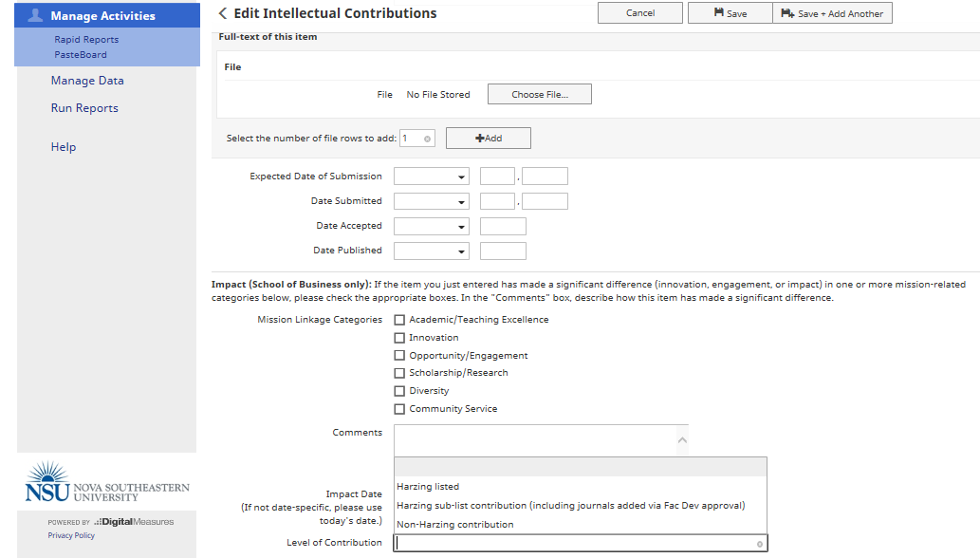
Journal Quality (Harzing)
Reporting

Slide 8
Impact Reporting How has the work you have done (Research, Teaching & Service) Made a difference?
You will see throughout the various screens an area in which we collect Impact.
Impact is telling the story of how your research, teaching and service has made a difference or fostered innovation.
Impact takes time to develop – in many cases beyond the 5 year reporting cycle – The Impact Date field captures these items
You can use Qualitative descriptions and/or Quantitative metrics
See guidance document for examples of impact and impact documentation
Not all work will have impact, but it is important to report when it does so we can celebrate these achievements!
Please make sure when you see a screen that asks you to input Impact that you think about the way in which the item entered your entry has made a difference.

